Slide 1


Baseball VI
Produced by Dr. Mario | UNC STOR 538

Slide 2
Win Probability Added
Motivation:
1951 Playoffs
New York Giants (H) Versus Brooklyn Dodgers (A)
Situation:
9th inning
Giants Losing By Two Runs
Runners on Second and Third
1 Out
Currently, Giants Have 27% Chance to Win
Bobby Thomson HR to Win Game Against Ralph Branca
Now, the Giants Have 100% Chance to Win Game
Goal: Measure an Athlete’s Ability to Help Team Win

Slide 3
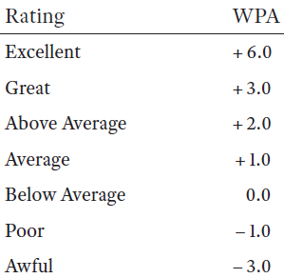
Win Probability Added
Win Probability Added (WPA)
Based off Scenario:
Thomson’s WPA: 1-0.27 = 0.73
Branca’s WPA: 0-0.73 = -0.73
WPA of a Player is a Difference Between
Win Probability After
Win Probability Before
WPA Changes for Every Plate Appearance

Slide 4
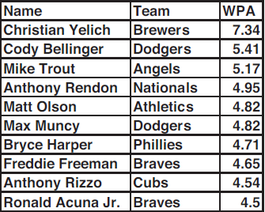
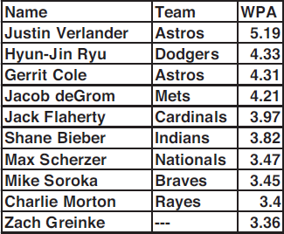
Win Probability Added
FanGraphs Calculation of WPA in 2019
Can Be Interpreted in Games Added

Slide 5
Win Probability Added
FanGraphs Calculation of WPA in 2019
Relief Pitchers Benefit From This Metric
Can Be Interpreted in Games Added

Slide 6

Win Probability Added
Fielding Ratings Into WPA
Prerequisites:
Outs Above Average (OAA)
Runs Prevented
10 Runs = 1 Win (Pythagorean Method)
Requirement: Convert Runs Prevented into Wins
Example: Cody Bellinger 2019
WPA = 5.41
Fielding Prevented 7 Runs More Than Average
WPA with Fielding
$$5.41+\frac{7}{10}=6.11$$

Slide 7
Win Probability Added
Base Running Into WPA
Good Base Runner Described
Rarely Caught Stealing and Stealing Often
Rarely Caught in Double Plays
Able to Take Extra Bases
FanGraphs Metrics
Ultimate Base Running (UBR)
Weighted Stolen Bases (wSB)
Weighted Ground Into Double Play (wGDP)
All Three Measure Runs Added Relative to Average Player
Example: Billy Hamilton 2016
UBR = 4.1, wGDP = 0.6, wSB = 8.1
Baserunning Runs Added = 12.8 Runs
Add 1.28 Wins to WPA

Slide 8
Wins Above Replacement
Keith Woolner
Works for the Cleveland Indians
Authored for Baseball Prospectus
Respected for Player Analysis and Market Evaluation
Created Value of Replacement Player (VORP)
Replacement Player
Players Create Value by Keeping Bad Players Off the Field
Acquiring Replacement Players (Minor League)
Assume List of Replacement Players is Infinite
Woolner Defined Replacement Player as a Player in the Bottom 20% of List Ordered by Plate Appearances
Fan Graphs Definition
20 Runs Below Average for a Season
Team of Replacement Players Win 48 Games Out of 162

Slide 9
Wins Above Replacement
Wins Above Replacement (WAR)
Attempt to Measure All of a Baseball’s Player’s Contributions
What is it good for? Absolutely Everything
Not Comparing to Average Player but Replacement Player
Interpretation: “If a player got injured and their team had to replace them, how many wins would the team be losing?
Three Main Sources of WAR
Baseball-Reference (bWAR)
FanGraphs (fWAR)
Baseball Prospectus (WARP)
Carefully Read Steps for Calculation of WAR in Textbook

Slide 10

Wins Above Replacement
Formula Differs for Position Players and Pitchers
Position Players: Batting, Baserunning, and Fielding Measured in Runs Above Average (RAA)
Pitchers: Either Based on Runs Allowed Per 9 Innings (RA9) or Fielding Independent Pitching (FIP)
General Formula for Position Players (fWAR)

Slide 11
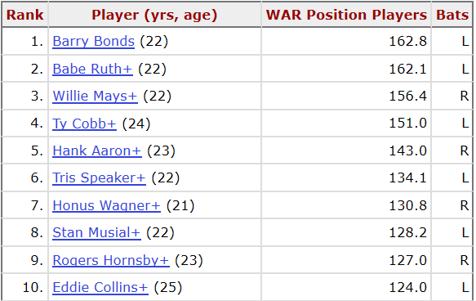
Wins Above Replacement
Top Players for bWAR Based on Career

Slide 12
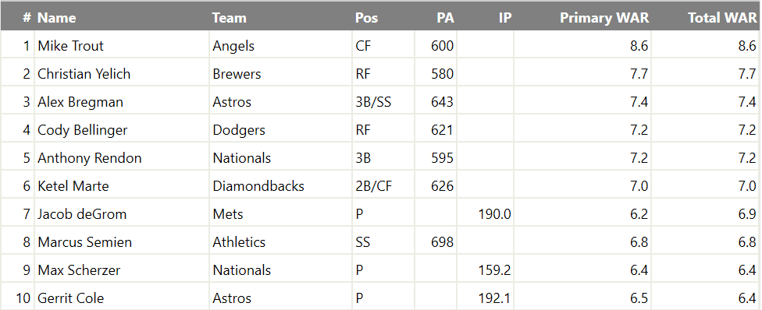
Wins Above Replacement
Top Players for fWAR Based on 2019 Season

Slide 13
Wins Above Replacement
Using WAR to Determine Player Salaries
Prerequisites:
Teams Have 25 Players
Minimum Salary = $500,000
Team of Replacement Players Win 48 Games
Salary for Team of Replacement Players = $12.5 Million
Average Team Salary in 2016 = $114 Million
Average Team Wins 81 out of 162 Games
Cost of 81-48=33 Wins is $114 – $12.5 = $101.5 Million
Each Win Above Replacement is Worth $3.08 Million

Slide 14
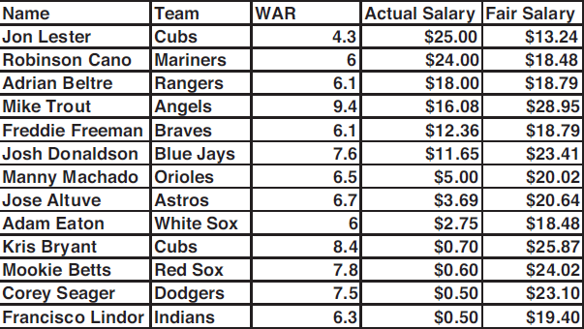
Wins Above Replacement
Salary Comparison in 2016
Winner’s Curse = Pay More Than Player is Worth

Slide 15

Final Inspiration
Yesterday’s home runs don’t
win today’s games.
-Babe Ruth

